Slide 1
Welcome to
Our Sunday School
We’ll start at 9:07
visit OurSundaySchool.com for more about our class

Slide 2
Today’s class (pages 176-185)
Philippians 2:28-30

Slide 3
Philippians 2:28-30 (CSB)
For this reason, I am very eager to send him so that you may rejoice again when you see him and I may be less anxious. Therefore, welcome him in the Lord with great joy and hold people like him in honor, because he came close to death for the work of Christ, risking his life to make up what was lacking in your ministry to me.

Slide 4
Today’s class (pages 176-185)
Philippians 2:28-30

Slide 5
BDAG on alupoteros (ALL-oo-poss) free from anxiety

Slide 6
Today’s class (pages 176-185)
Philippians 2:28-30

Slide 7
Christian relationships
“in the Lord”
E
Philippians

Slide 8
Today’s class (pages 176-185)
Philippians 2:28-30

Slide 9
Our Sunday School New Testament Series, Volume 11 Philippians: Part 2

Slide 10
Prayer Time
Write down your prayer requests (on the Weekly Update or in the comments)
Lean in, engage, and pray for someone not with you
Go worship

Slide 11
Today’s class (page 16)
Preparing for Philippians 1:1-30
Pray with others
Hear with others
Think with others
Study with others In class, as a table
Share with others
Invite others After class
In class, as a class

Slide 12
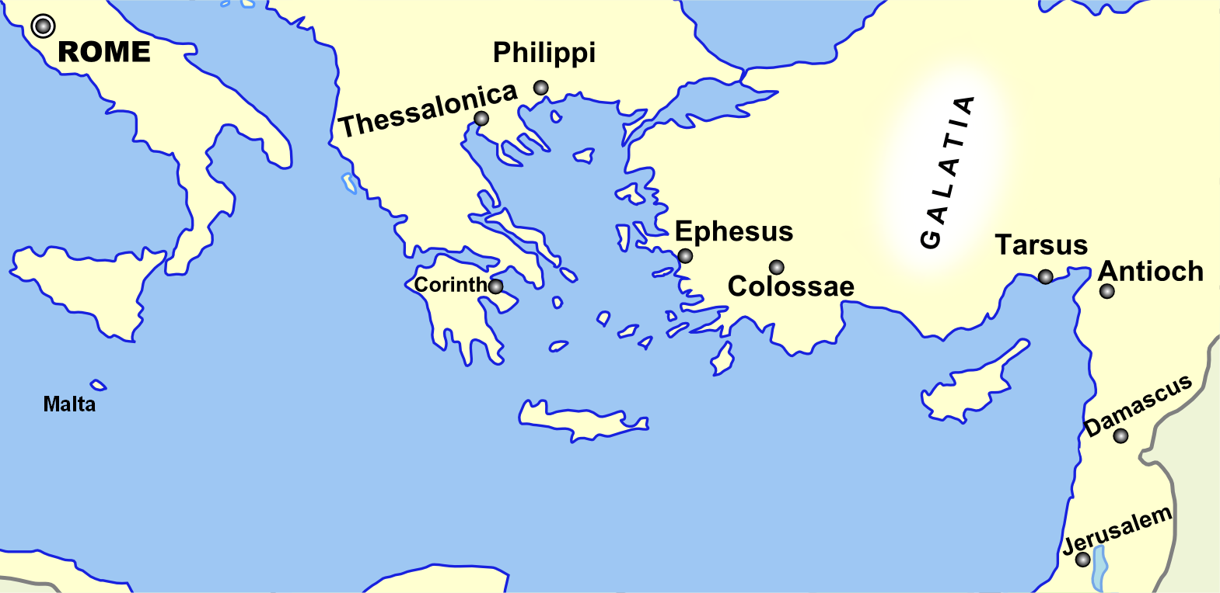
Monozigote. (2012). Broad Overview of Geography Relevant to Paul of Tarsus [Map]. Wikipedia.

Slide 13
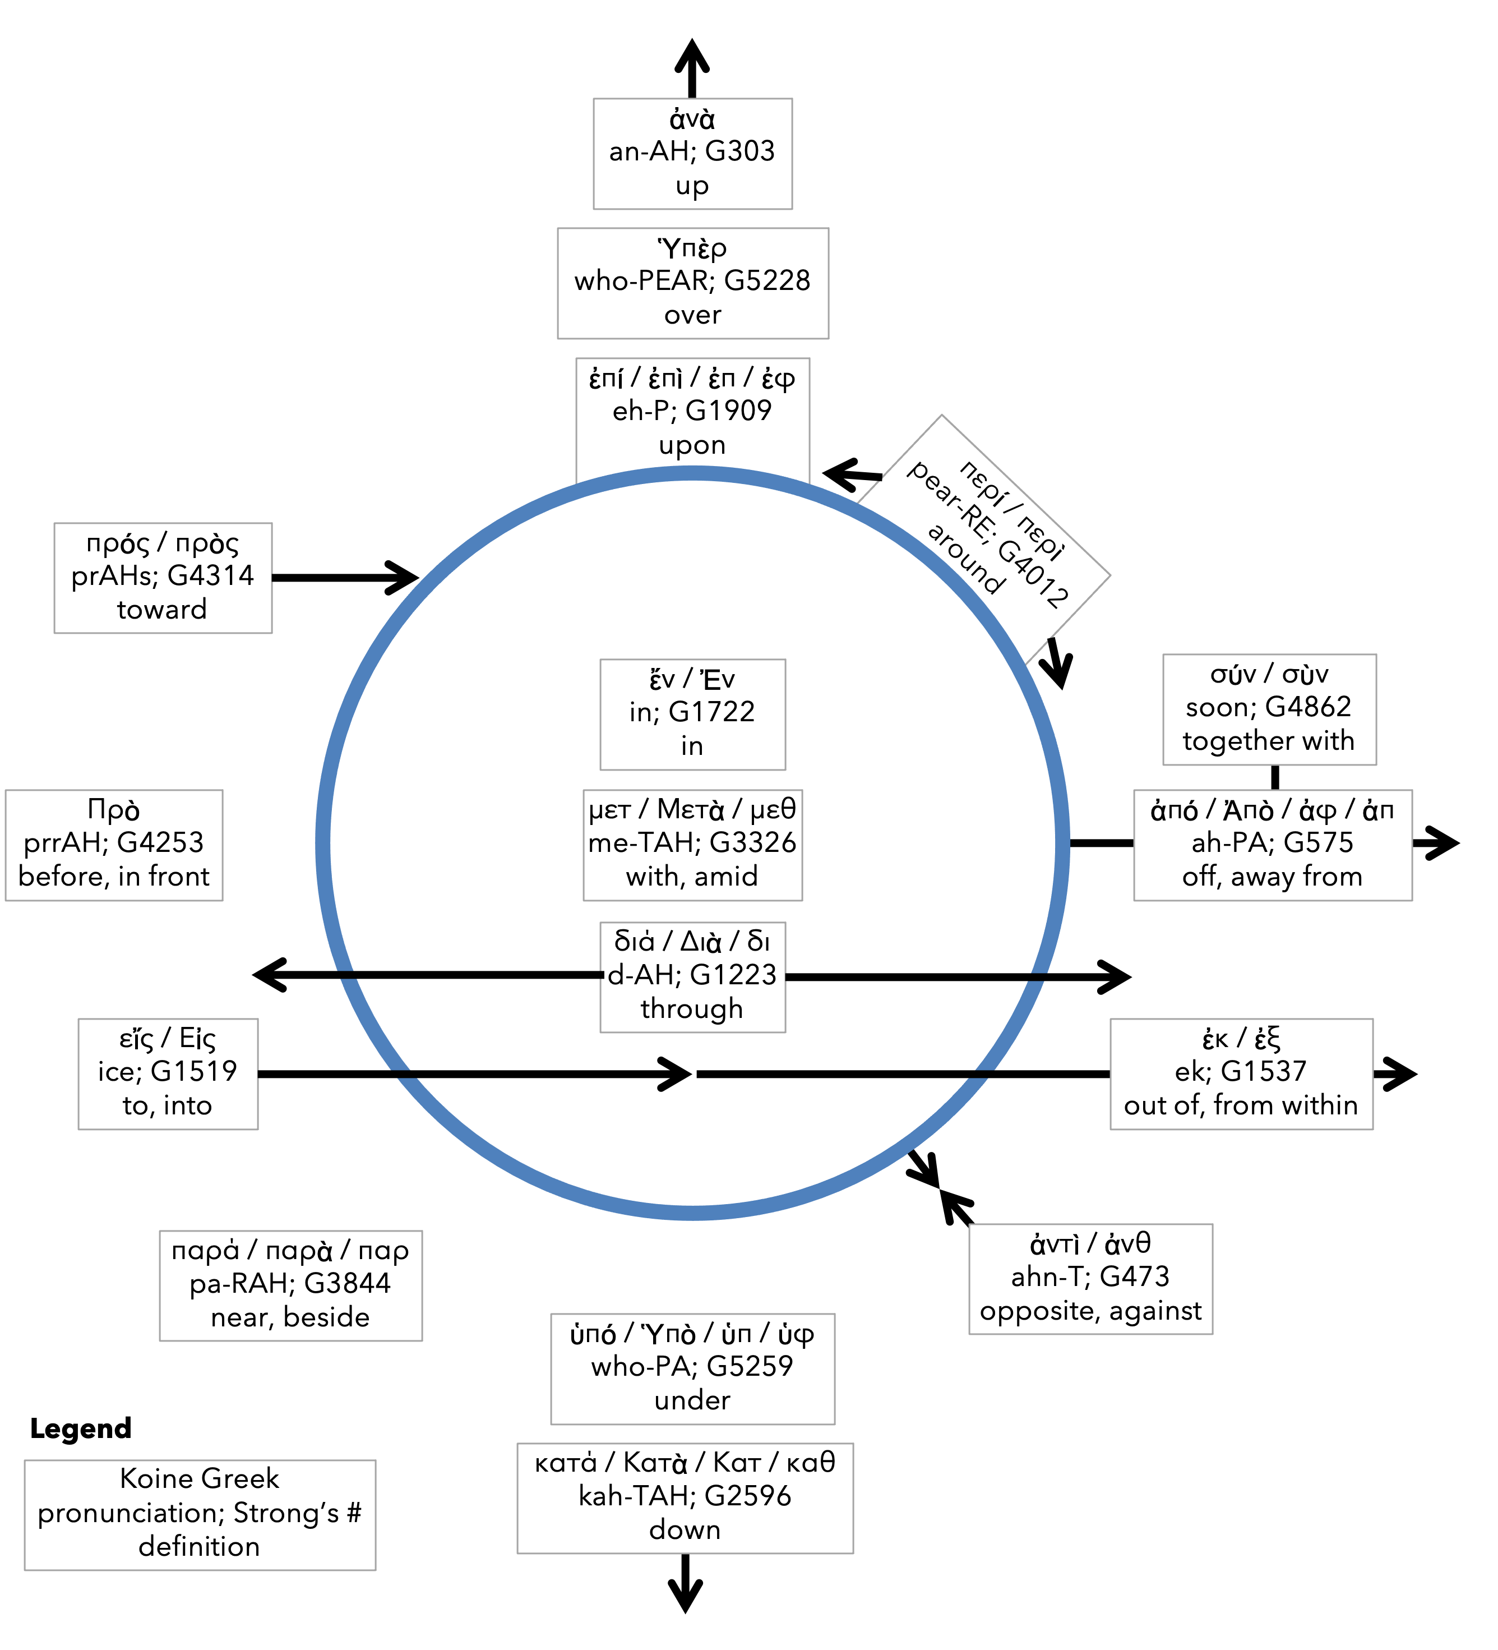
Preposition circle (page 11)

Slide 14
BDAG on morphe (mor-FAY) form, outward appearance, shape

Slide 15
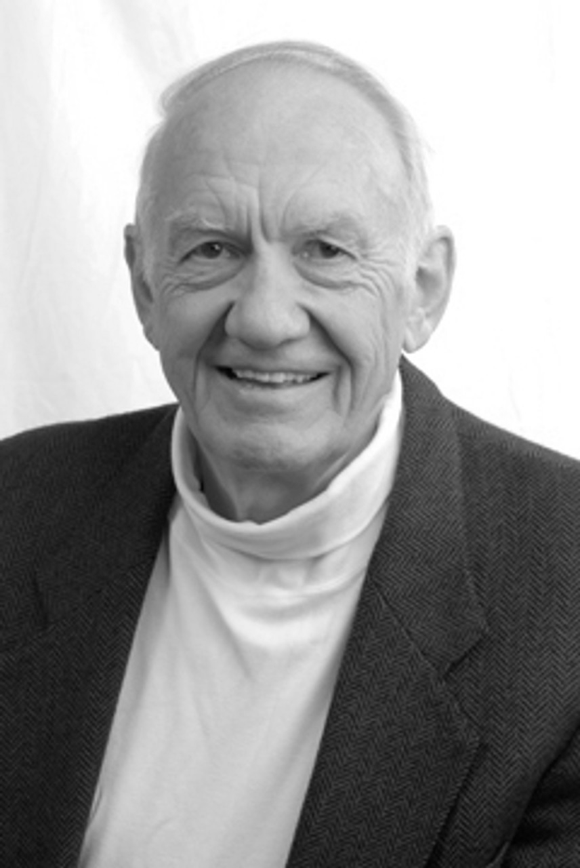
Dr. Gordon Fee Quote

Slide 16
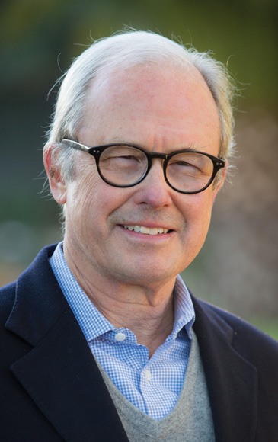
Dr. G. Walter Hansen Quote

Slide 17
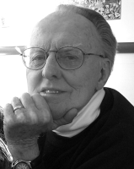
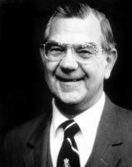
Dr. G. F. Hawthorne & Dr. Ralph P. Martin Quote

Slide 18
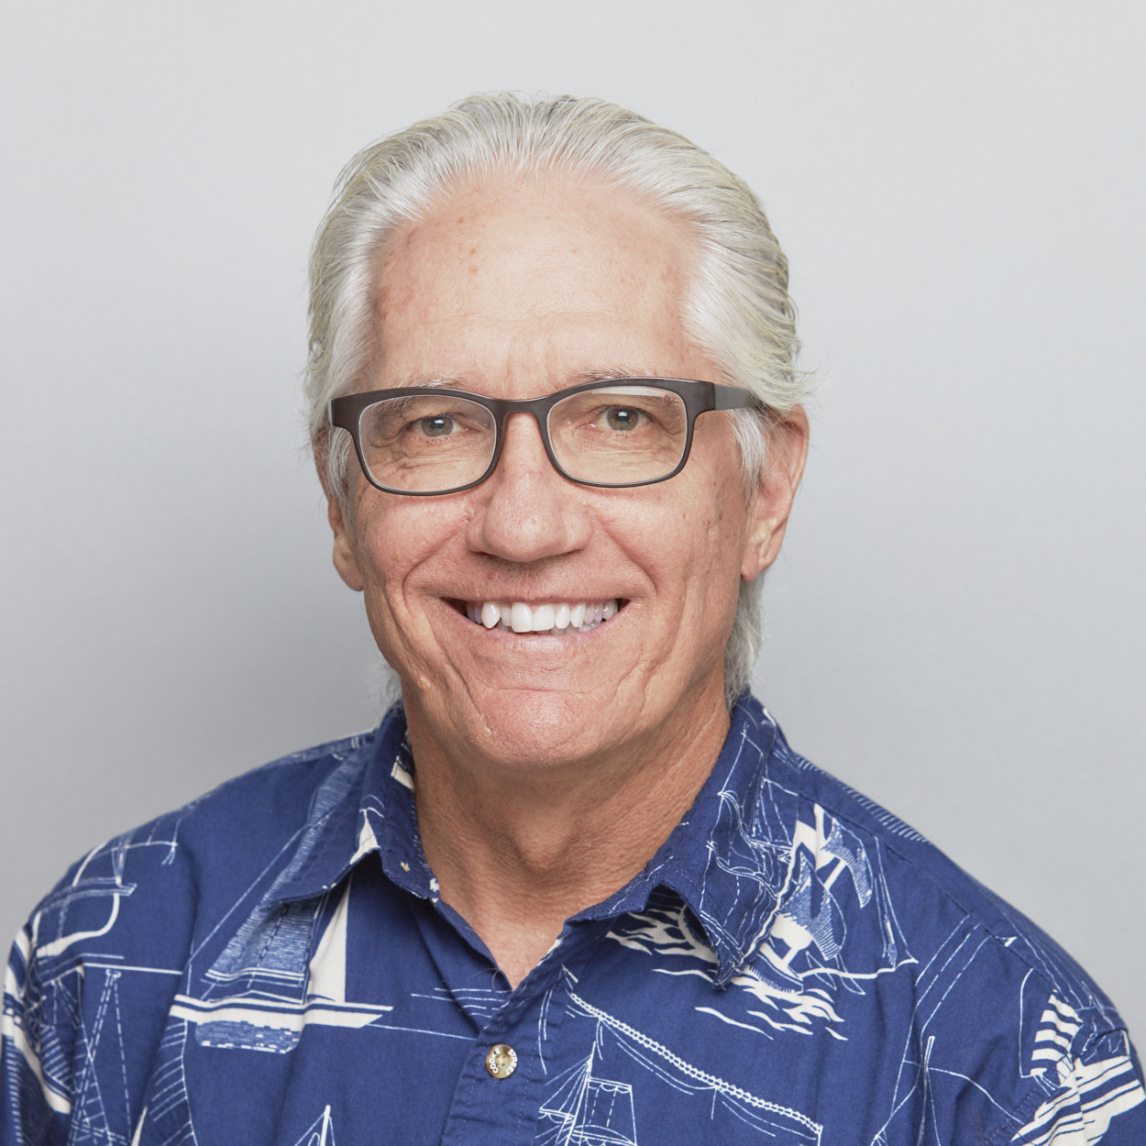
Dr. Joe Hellerman Quote

Slide 19
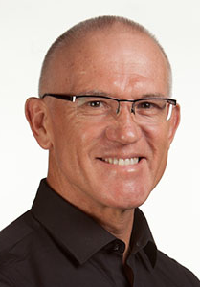
Dr. Mark Keown Quote

Slide 20
Dr. Ralph P. Martin Quote

Slide 21
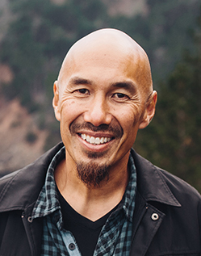
Dr. Tony Merida & Frances Chan Quote

Slide 22
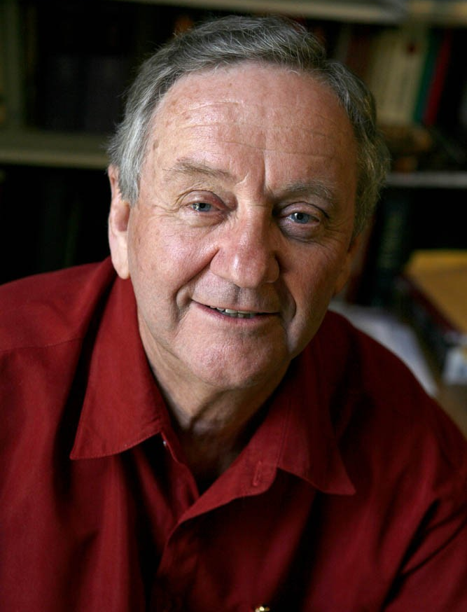
Dr. Peter T. O’Brien Quote

Slide 23
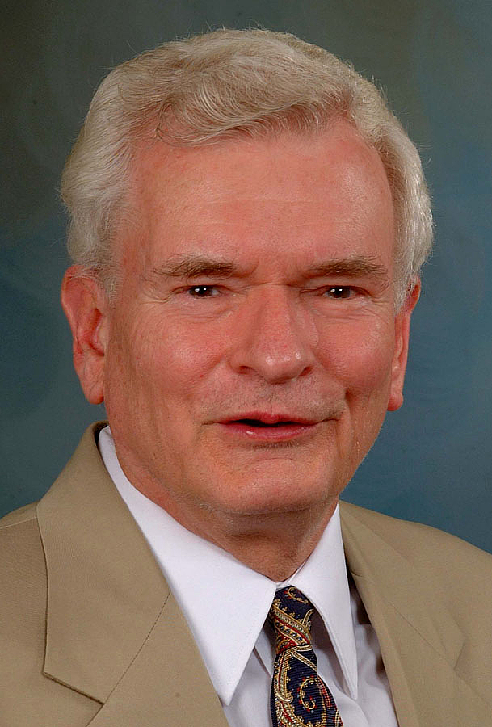
Dr. John Reumann Quote

Slide 24
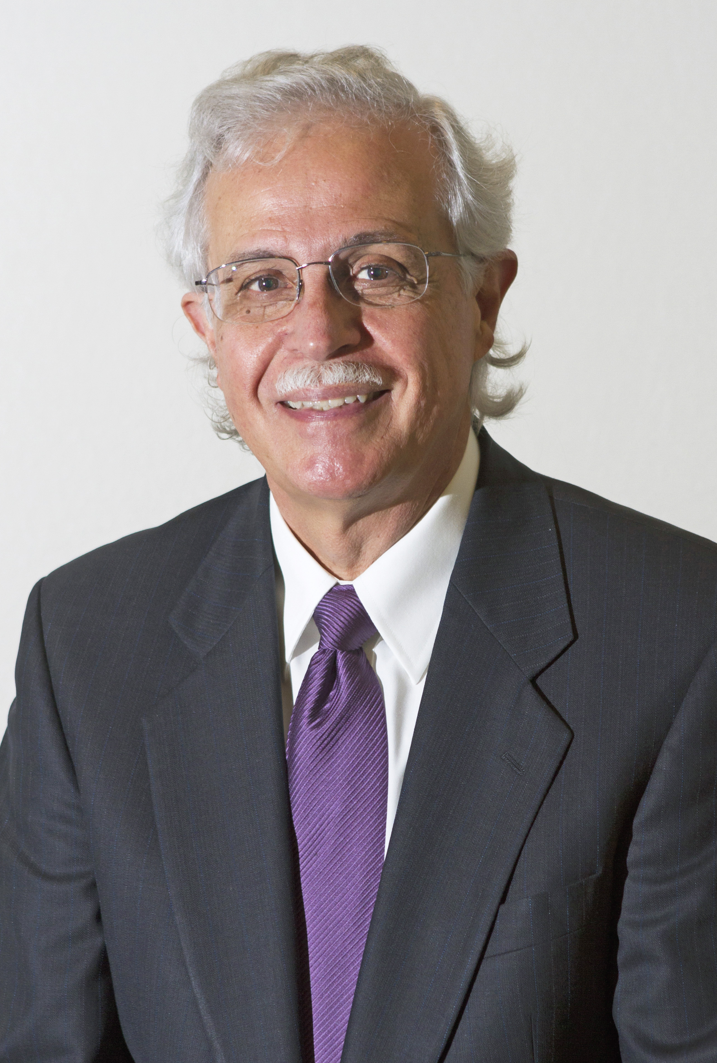
Dr. Moises Silva Quote

Slide 25
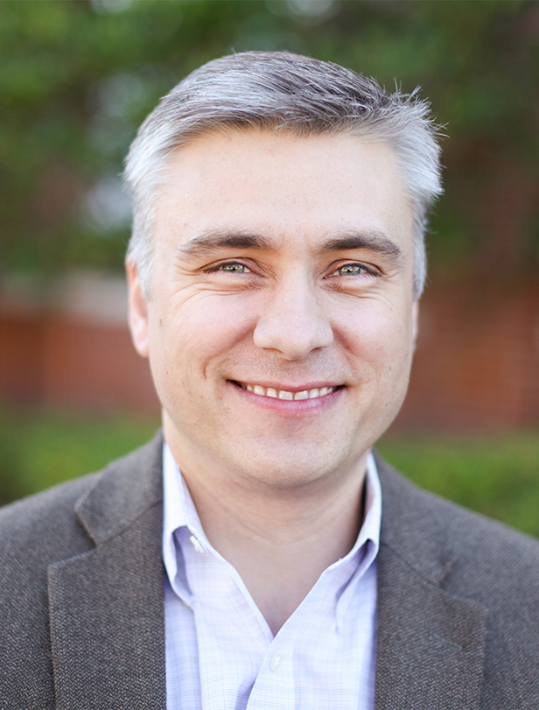
Dr. David T. A. Strain Quote

Slide 26
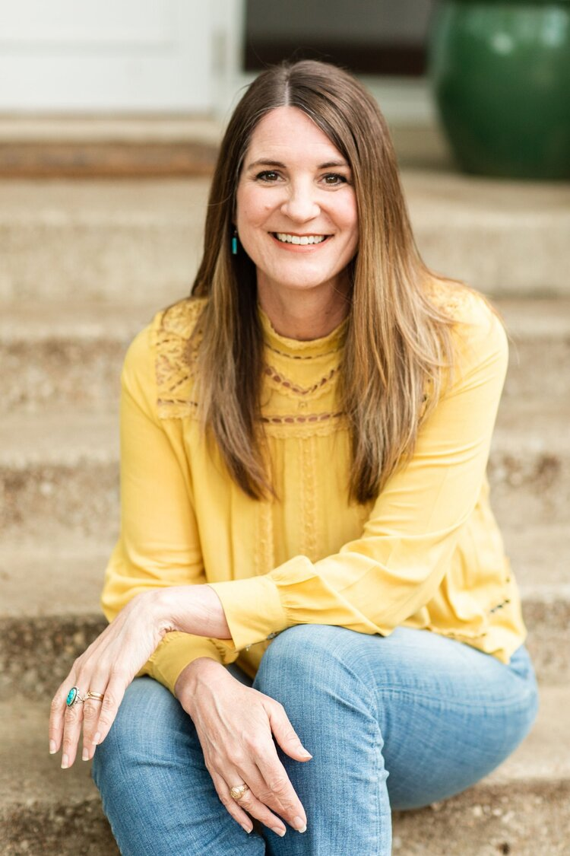
Jen Wilkin Quote

